Slide 1
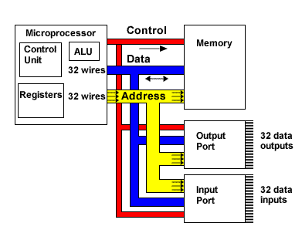
CSE360-Computer Interfacing BRAC University
Bus Interfacing

Slide 2
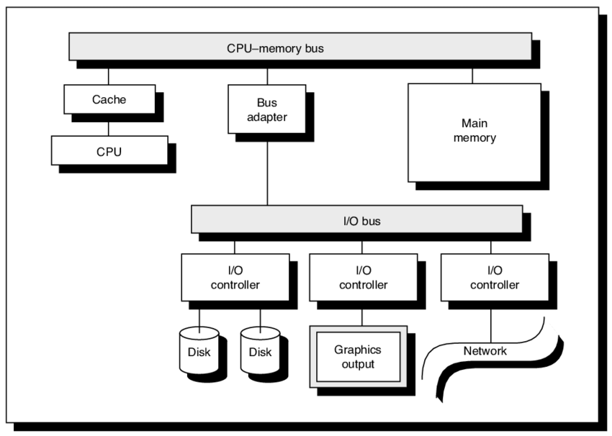
Figure: Different components interfaces with shared bus line

Slide 3
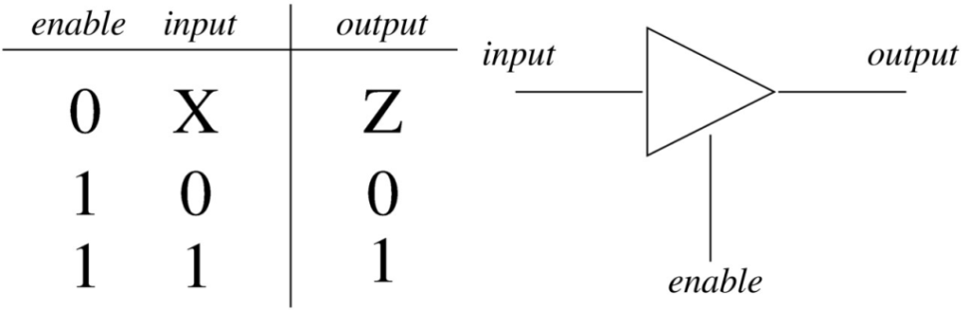
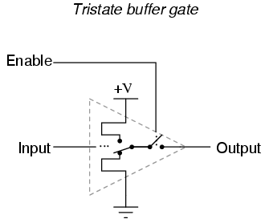
Tri- state Bus
Buses and Tri-state Logic
In Tri-state, only one device can access the
bus at anyone time.
The basic concept of the third state, high impedance (Hi-Z), is to effectively remove the device's influence from the rest of the circuit.

Slide 4
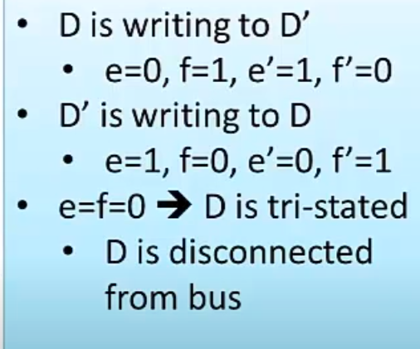
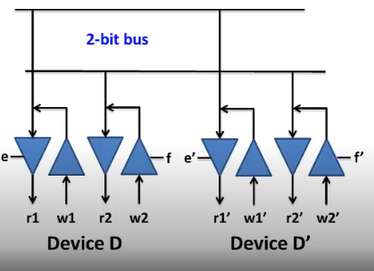
How Tri-Stating works
Image and content credit goes to - https://www.youtube.com/channel/UCtaUBoxL2DvNydL3r5KuQOg

Slide 5
Advantages of Tri-State Bus
To resolve conflict between multiple sources driving the shared bus line.
To use the same port as both for input and output operation. Note: not all devices need to drive all bus lines.
It higher the bus fan out.

Slide 6
External Bus Interface
An external bus is a type of data bus that enables external devices and components to connect with a computer.
It enables connecting devices, carrying data and other control information, but is only restricted to be used external to the computer system.
An external bus is also known as external bus interface (EBI) and expansion bus.
These devices can include storage, monitors, keyboard, mouse and more.

Slide 7
External Bus Interface
Slower than internal buses.
An external bus can be both serial or parallel.
Universal Serial Bus (USB) , PCI bus and IEEE 1294 are common examples of external buses.

Slide 8
Bus Interfacing
Bus Master:
The device that determines who will speak and who will listen is called the bus master.
Usually, the CPU is the bus master, but some clever buses can allow other devices to take over when necessary.
Input and output are always designated relative to the bus master.
A READ means data is going into the bus master.
A WRITE means that data is going out from the bus master.
***Each bus has several lines dedicated to one of three separate duties.

Slide 9
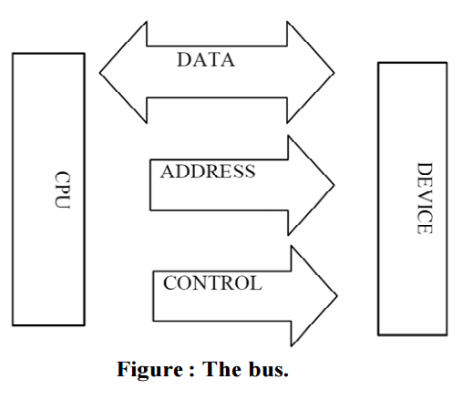
Bus Interfacing
Each bus has several lines dedicated to one of three separate duties.
Control lines are (mostly) unidirectional. They coordinate data transfer.
Address lines are unidirectional.
The bus master uses them to
designate which device it wants
to communicate with.
Data lines are bidirectional
so that they can carry binary data
into or out from the bus master.

Slide 10
Bus Interfacing
Bus Errors/Conflict
Only one I/O device is allowed to share a bus at any one time as OUTPUT.
If two or more I/O use the bus as OUTPUT causes bus conflict.
If one I/O is used as OUTPUT and multiple I/O are used as INPUT causes NO bus error.
Causes of Bus Error:
1. Caused by multiple device using the bus as Output
2. Wait states are not maintained
3. If an I/O device causes the bus pin to stuck at 1 or 0.
4. Caused by glitch.

Slide 11
Causes of Bus Error
Wait State: A time-out period during which a CPU or bus lies idle. Wait states are sometimes required because different components function at different clock speeds.
For example, if the CPU is much faster than the memory chips, it may need to sit idle during some clock cycles so that the memory chips can catch up.
If wait states are not maintained properly, there will be no synchronization in bus line and it will occur bus error.
Glitch: A glitch is a short-lived fault in a system. It is often used to describe a transient fault that corrects itself, and is therefore difficult to troubleshoot.
Example: Effects of glitches on the data line which can cause an I²C bus (or SMBus) interface to invalidate a detected I²C start command or to erroneously detect an I²C start command, which occurs when the data signal transitions from a logic high to a logic low while the clock signal has a logic high, are reduced by detecting the logic state of the data signal when the clock signal next transitions from a logic high to a logic low.

Slide 12
The End

